Slide 1
Media Recommendation
Robert Gingras, Henry Green, Rowan Akers, Benny Bergle

Slide 2
Search & Filter
The search screen will be the first page a user sees.
Simple layout with a logo & search bar.
React components
Query MongoDB database with user input using NodeJS
Displays saved pages for logged-in users
The filter screen will be the second page a user sees.
Display requested results and filters
Filters will allow the removal of media containing certain tropes from results
Search…
Watch Later
Search…
Filters…
Results…

Slide 3
Recommendation & External APIs
The recommendation page will be where you can find related media based on your input
The use of multiple APIs will help get correct images, titles and descriptions for TV shows, Movies and video games
It will show the media you searched for with related media underneath like amazon’s “People who buy this also buy”
Logged-in users can “Like” a recommendation
Image
Details
Related

Slide 4
Login and Save
Users can login via a simple login flow
Create user (username, password, confirm password)
Login (username, password)
A logged in user can
Save a media page, like a watch later
“Like” a recommendation, which ranks it higher for other users

Slide 5
MongoDB & Normalization
Using the MongoDB Node driver to work with Node.js
MongoDB Atlas
Database migration
Cloud control
SQLitemongo tool
Open-source tool helps convert SQLite files to MongoDB
Avoids duplicate uploads and converts with a small number of commands
Data normalization
Streamline searching
Reduce size of database
Reduce redundancy
Increase integrity

Slide 6
Server API
Provides JSON response to queries about specific searches and media
“/search” endpoint
“?title=” returns results of media which case-insensitive wildcard match the provided string
“?filters=” comma separated list of trope filters, which queries for the intersection of media associated with those tropes
“/recommendation” endpoint
“?id=” the unique key for the media record the user is querying

Slide 7
Server API Cont.
“/like” endpoint
PUT
“?uid=” user that liked the media, ensures a user can only “like” the recommendation once
“?id=” tuple of which media was search and which was recommended
GET
“?id=” returns associative array of related media and count of “likes”
DELETE
“?uid=” the user that wants to remove their like
“?id=” the tuple which the user is trying to remove their like from
“/saved” endpoint
PUT
“?uid=” the user that saved the media
“?id=” the media that was saved
GET
“?uid=” the user who’s saved media should be queried
DELETE
“?uid=” the user who is trying to un-save a media
“?id=” the media that the user is trying to remove

Slide 8
Optional Requirements
Continuous web crawling
Metadata about piece of media
Paging system for server endpoints

Slide 9
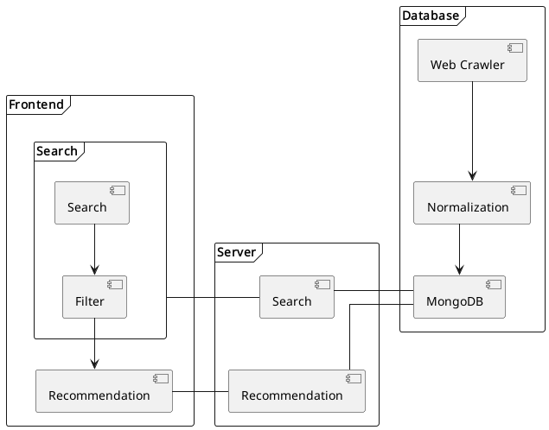
The Diagram

